Slide 1

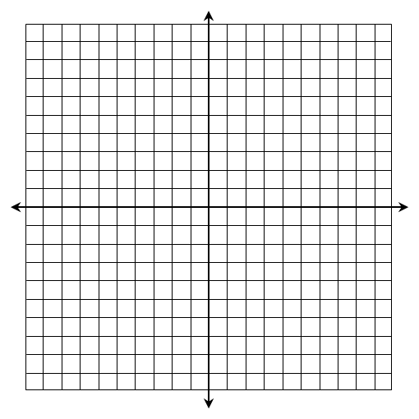
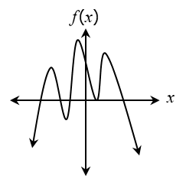
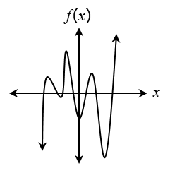
Graph the function below and identify its key characteristics.
1.
Domain: _____________________________________ Range: ______________________________________ Rel. Maximum(s): ____________________________ Rel. Minimum(s): _____________________________ End Behavior: As _______ As _______ Inc. Intervals: _______________________________ Dec. Intervals: ______________________________ Zeros: ______________________________________
Given the graph, determine whether the degree is even or odd and the leading coefficient is positive or negative.
2.
3.
Degree | Leading Coefficient
Degree | Leading Coefficient
Even
Odd
Positive
Negative
Even
Odd
Positive
Negative
Identify the zeros, their multiplicity, and their effect on the graph of the function.
4
5
Zero | Multiplicity | Effect
Zero | Multiplicity | Effect

Slide 2

6. A polynomial function has a zero at 4 (multiplicity 3) and 0 (multiplicity 1). Write a function in standard form that could represent this function. Box your final answer.
Solve each equation by factoring. Simplify all irrational and complex solutions.
7.
8.
9.
10.
11.
12.

